Slide 1
A New Era: VERACIOUS
NSA / JSIG Joint Presentation
Presented by Taylor Badt, Peter Kinder, and Blanca Munoz Perez

Slide 2
“All war is deception.” -Sun Tzu
Notes:
In 5th century BC one of the most famous war strategists Sun Tzu, said “All war is deception.” This was a true then as it is now and was on…

Slide 3
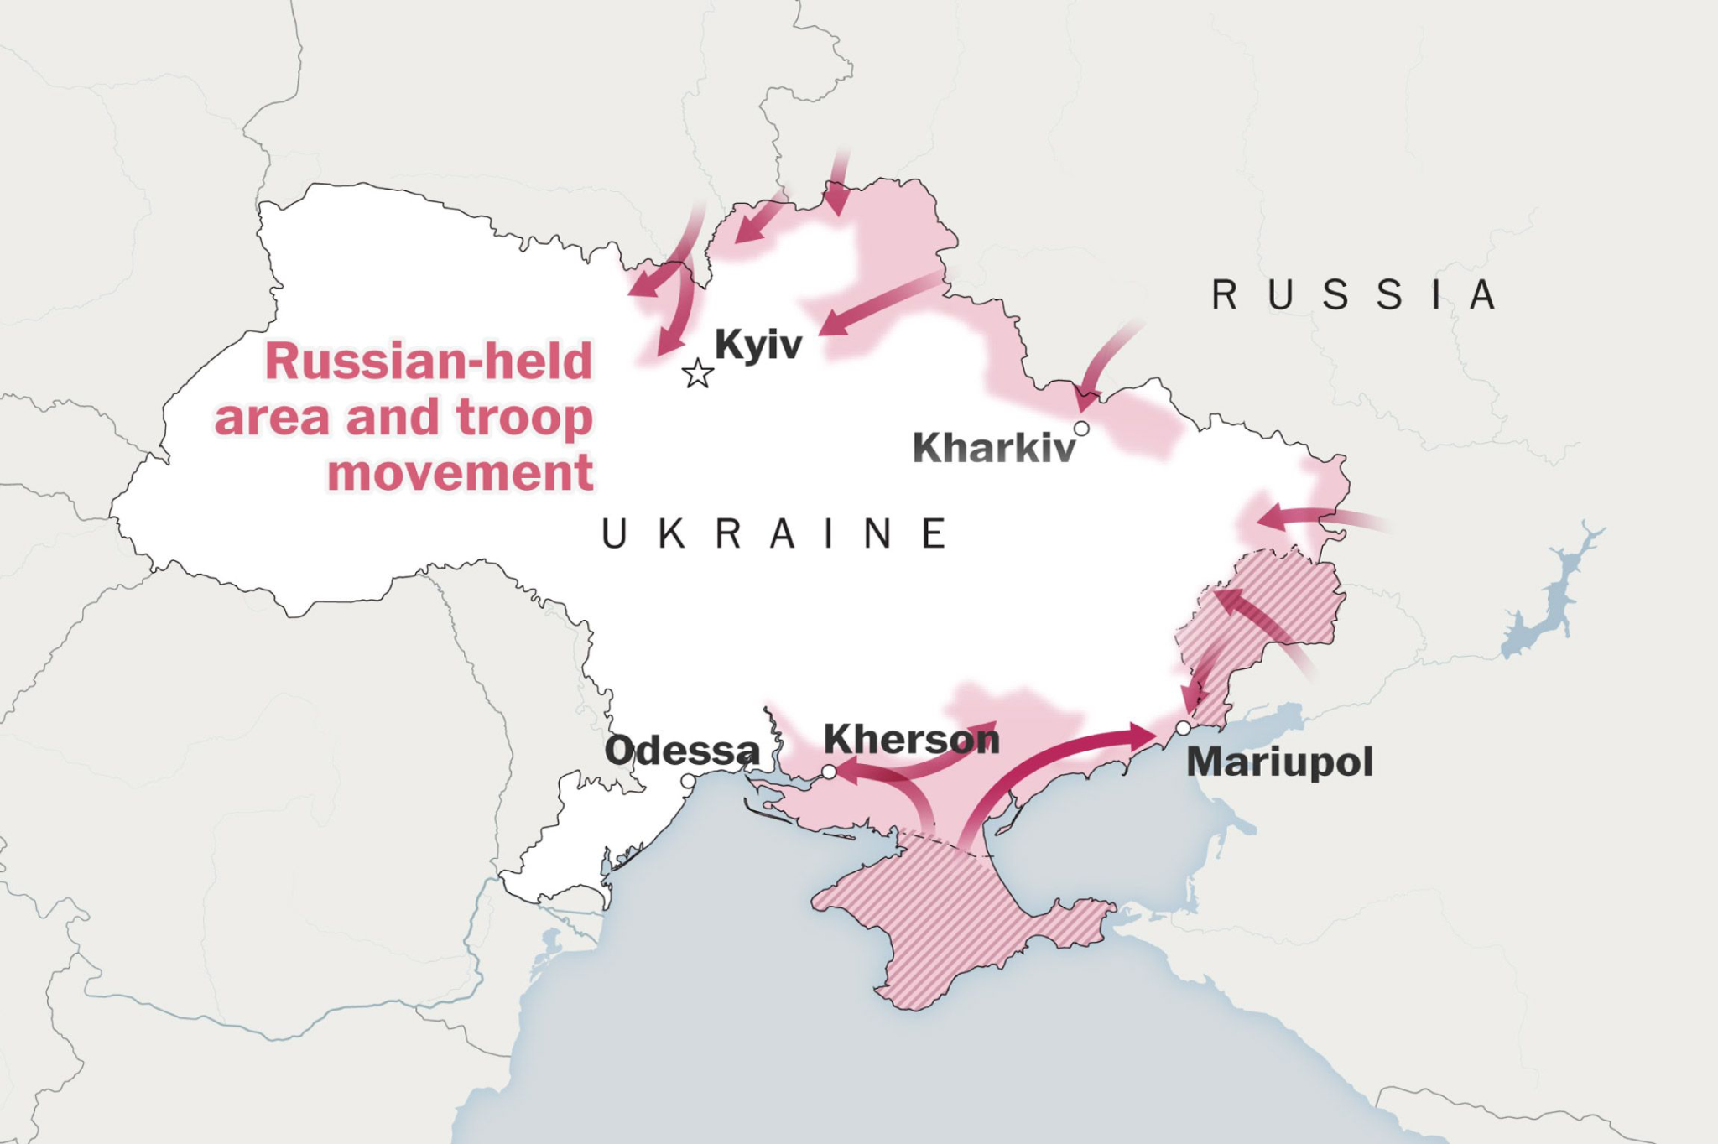
February 24, 2022
Notes:
picture from Feb 24th, 2022
source: https://www.washingtonpost.com/world/2022/02/24/maps-ukraine-russia-attack/
pi24, 2022

Slide 4
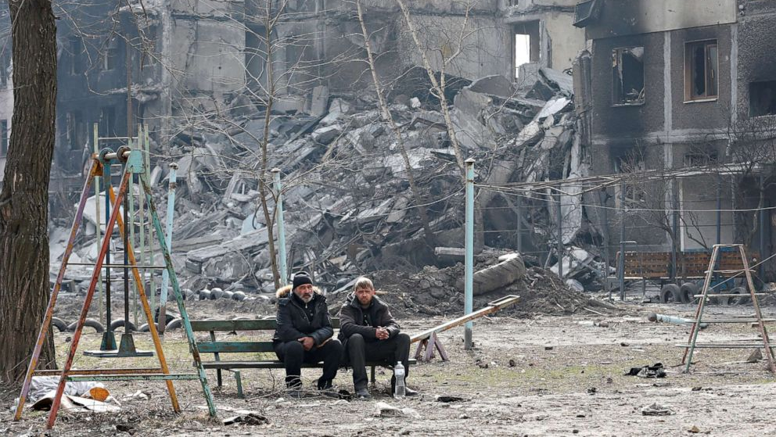
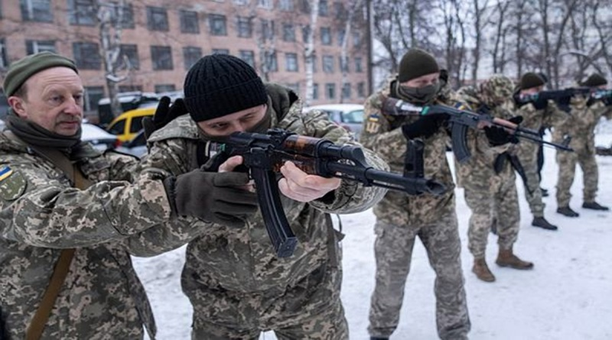
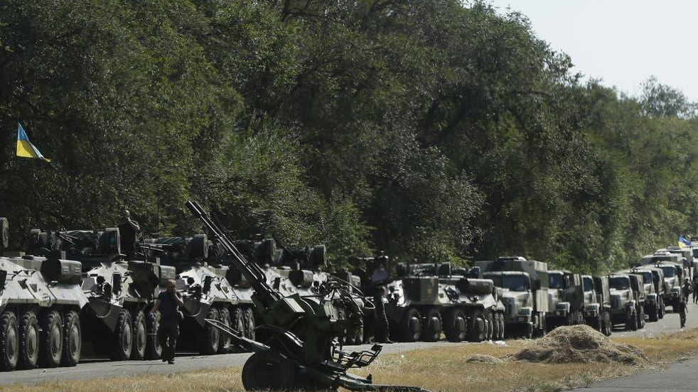
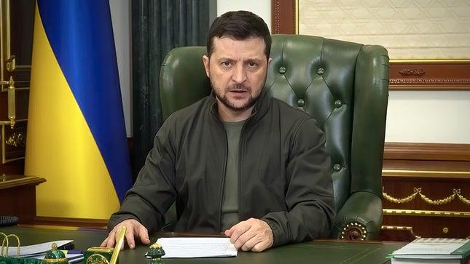
Notes:
convey kinetic warfare
Mariupol, Kramatorsk, And Bucha

Slide 5
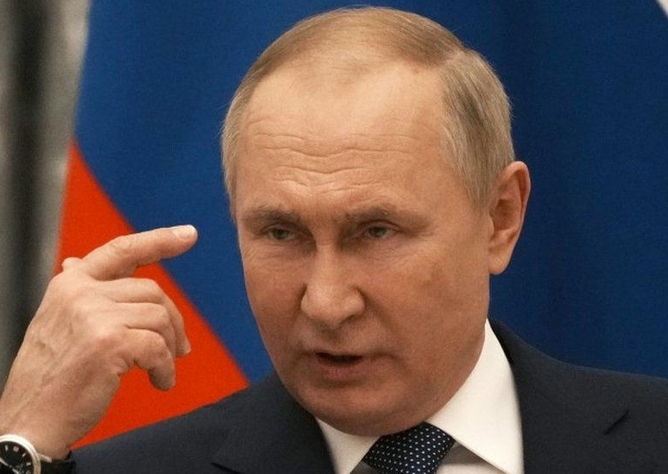
Russian President KGB/FSB Officer
SANCTIONED
Largest Nuclear Stockpile
Prolific Disinformation Disseminator
Notes:
feel like we should edit putin’s title

Slide 6
Disinfo Narrative Examples
Liberators of Ukraine
Removing Neo-Nazis
Genocide in Donbas
US Bioweapon Labs
Bucha Hoax

Slide 7

NSA Challenge
Identify and analyze foreign disinformation campaigns in order to inform cybersecurity priorities.

Slide 8

JSIG Challenge
Create a tool to measure the effectiveness of Information Operations.

Slide 9
Countermeasures
Identify and Map Disinformation Campaigns
Determine Distinguishing Disinformation Features
Covert Behavioral Surveying

Slide 10
Identifying & Mapping
Identify Individual Disinformation
Machine Learning
Classification Target
Label Propagation
Map Identified Disinformation
Deep Learning
Text Analysis
Clustering
Notes:
this is too much text for one slide

Slide 11
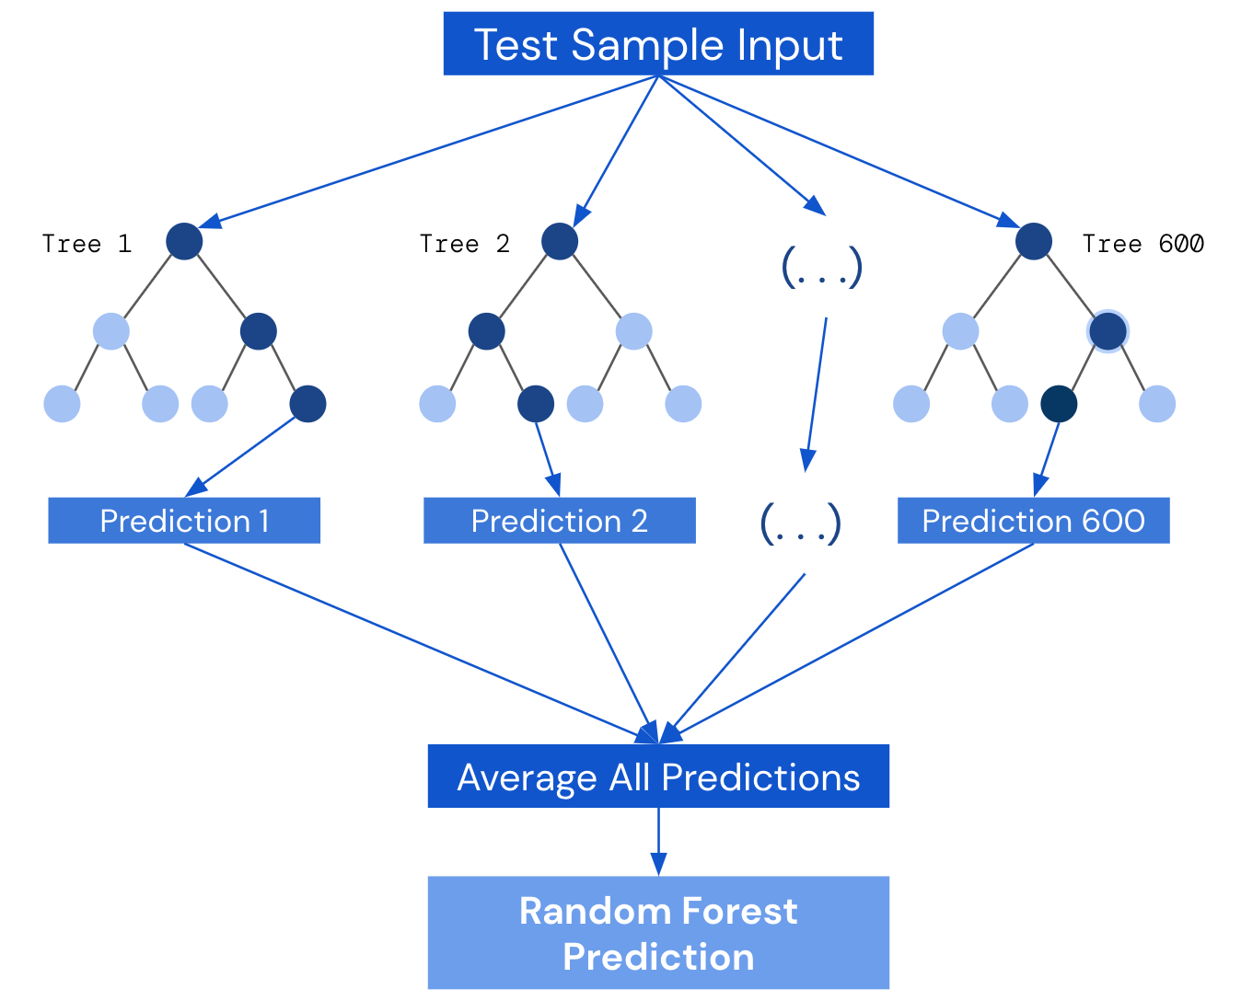
Machine Learning
Branch of AI & Computer Science
Making Classifications
Notes:
Machine learning is a branch of AI and computer science which focuses on the use of data and algorithms to imitate the way that humans learn to make classification (decide whether tweet is IO) or predictions, uncovering key insights into data correlation.

Slide 12
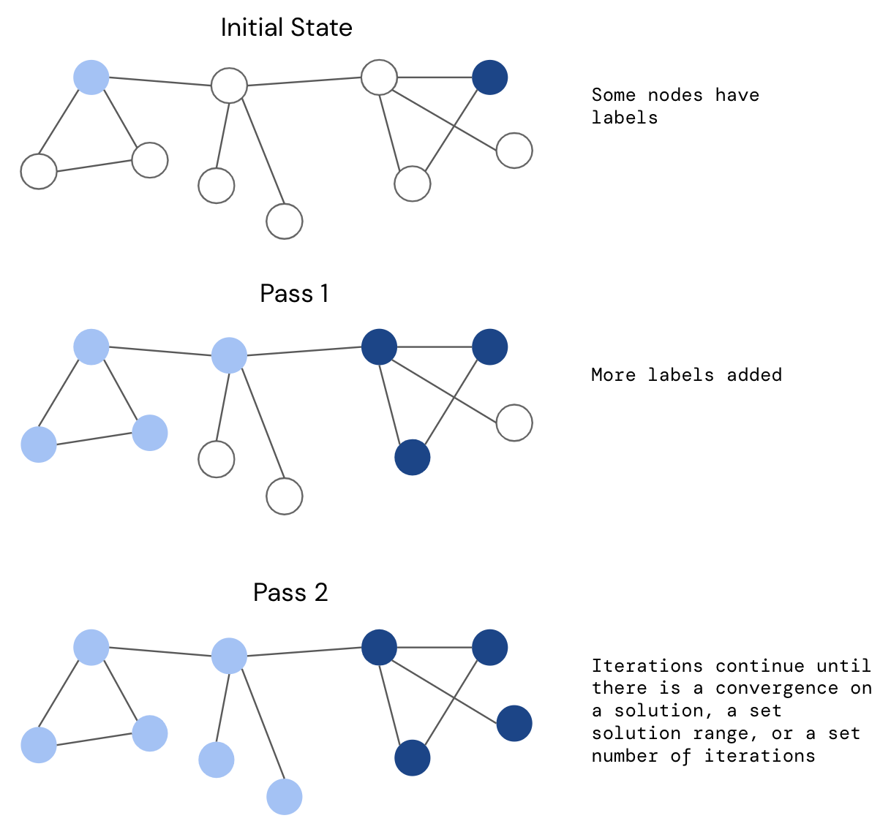
Label Propagation
Semi-Supervised Machine Learning
Training -> Deploy
Notes:
Label propagation is a method used by machine learning models. Its an algorithm that assigns labels to previously unlabeled data points
We first give the machine learning model training data which includes the parameters and results. Therefore, it is able to understand the patterns. Then, we give the machine learning model only the features and ask it to predict the results.
More specifically, we first give the machine learning model training parameters and whether that tweet was a Russian information tweet. Then it is able to understand what are the most important patterns in Russian information tweets. Secondly, we provide the machine learning model with only the parameters and ask the machine learning to make a prediction on whether that tweet is a Russian information tweet.

Slide 13
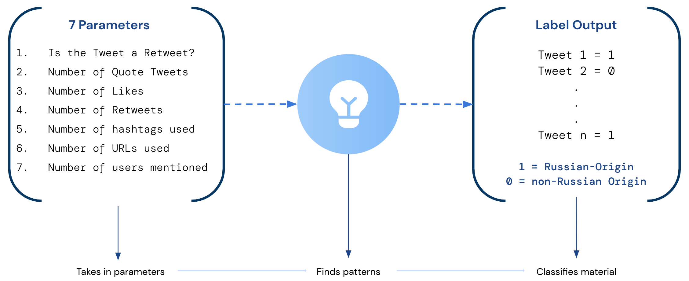
Veracious Model
Notes:
This product is a machine learning model that is able to identify Russian information operations tweets.
The model uses 7 parameters to be able to make the decision on whether a tweet is a Russian information operation tweet or not
The parameters are:
Whether a tweet is a retweet
Number of times the tweet was quoted (retweets with comments)
Number of times the tweet was liked
Number of times the tweet was retweeted
Number of hashtags used
Number of URLs used
Number of users mentioned
Now the machine learning algorithm tries to find commonalities and patterns between the parameters. For example, the machine learning algorithm finds a commonality between the number of URLs used and Russian information operations tweets.
Then, it tries to classify the tweet as an information operation tweet or not using the patterns it found.

Slide 14
Behavioral Features
Parameters
Whether a tweet is a retweet
Number of times the tweet was quoted (retweets with comments)
Number of times the tweet was liked
Number of times the tweet was retweeted
Number of hashtags used
Number of URLs used
Number of users mentioned
Notes:
This product is a machine learning model that is able to identify Russian information operations tweets.
The model uses 7 parameters to be able to make the decision on whether a tweet is a Russian information operation tweet or not
need to work on the aesthetics of this slide
Now the machine learning algorithm tries to find commonalities and patterns between the parameters. For example, the machine learning algorithm finds a commonality between the number of URLs used and Russian information operations tweets.
Then, it tries to classify the tweet as an information operation tweet or not using the patterns it found.

Slide 15
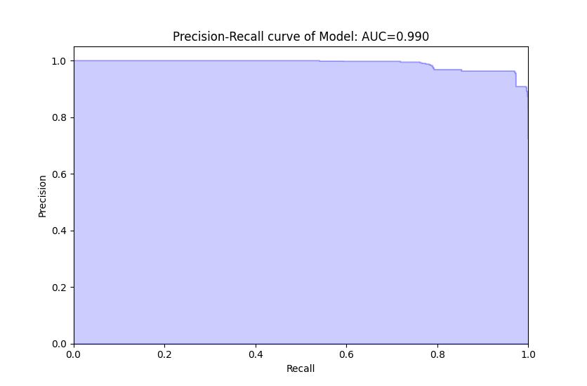
Model Metrics: Precision vs. Recall
Recall = TN/(TN+FP)
Test Average Precision: 0.990
Accuracy 0.965
Area Under the Curve: 0.990
Max AUC: 1
Notes:
A high area under the curve represents both high recall and high precision, where high precision relates to a low false positive rate, and high recall relates to a low false negative rate.
Small false positive rate due to high precision and small false negative rate due to high recall.
Precision: How close or dispersed the measurements are to each other in the defined area?
Accuracy: How close or far off a given set of measurements (observations or readings) are to their true value (are the arrows hitting the target?)
True positive: malicious activity (marked IO)
False positive: marked as malicious but benign
True negative: benign
False negative: marked benign but was malicious
Notes: Talk about area under the curve first. set up the stage for the two variables.

Slide 16
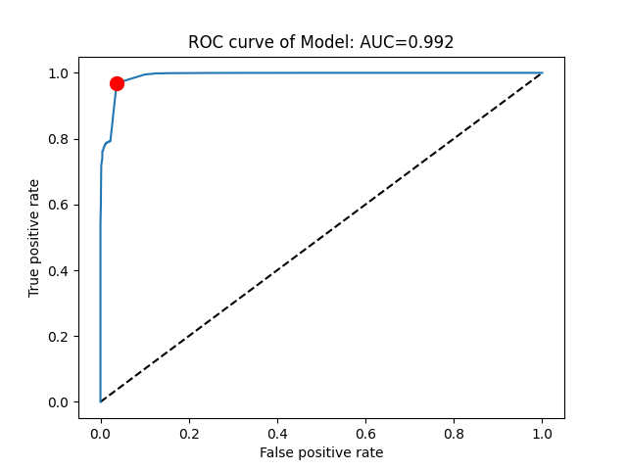
Model Metrics: ROC Curve
Optimal point (0.0366 0.969) (FPR, TPR)
Test Receiving Operating Characteristic AUC: 0.992
Notes:
A Receiver Operator Characteristic (ROC) curve is a graphical plot used to show the diagnostic ability of binary classifiers. Meaning, how well it is finding the distinction between a Russian IO tweet and a legitimate tweet.
Here we can see, the model is doing well since the true positive rate is high but the false negative rate is low
Notes: No need to repeat something that you have said

Slide 17
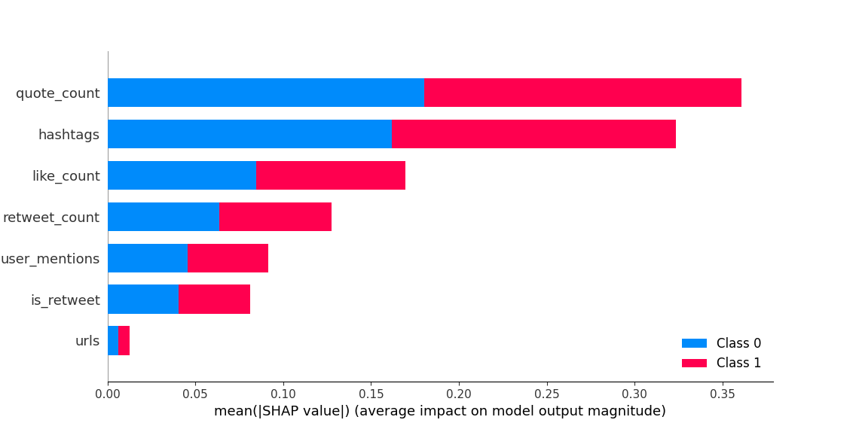
Value to Sponsors: SHAP Values
0.992
Notes:
is there another way to put value? i dont want to say value twice
SHAP Values: show which feature was the most important when distinguishing between Russian IO tweets and legitimate IO tweets. Therefore, we can now see what are the features that makes IO tweet behavior easy to find and tailor IO accordingly.

Slide 18
Identify -> Map

Slide 19
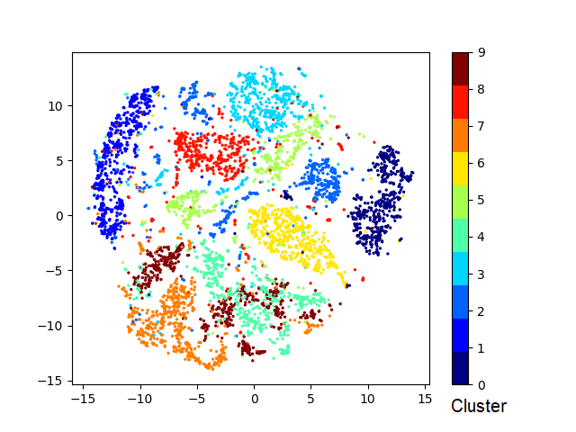
Mapping
Liberators
of
Ukraine
Removing
Neo-Nazis
Growth Rates
POS Extraction
Word Cloud
Source Tracking
Exposure Inference
US
Bioweapons
Lab
Bucha
Hoax
Genocide
in
Donbas

Slide 20
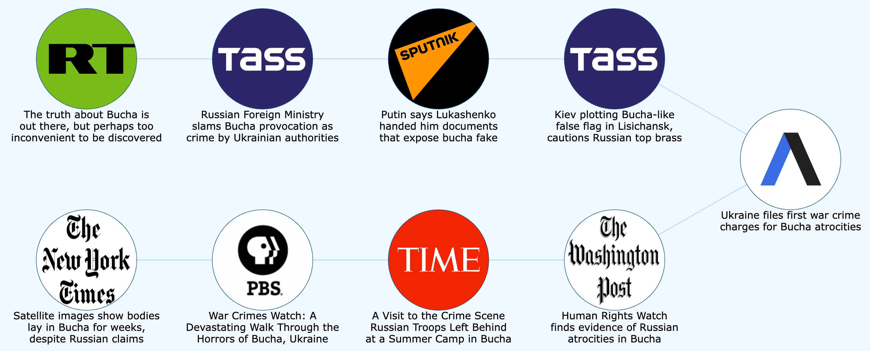
Narrative Mapping
Notes:
A Receiver Operator Characteristic (ROC) curve is a graphical plot used to show the diagnostic ability of binary classifiers. Meaning, how well it is finding the distinction between a Russian IO tweet and a legitimate tweet.
Clearly, the model is doing well since the true positive rate is high but the false negative rate is low

Slide 21
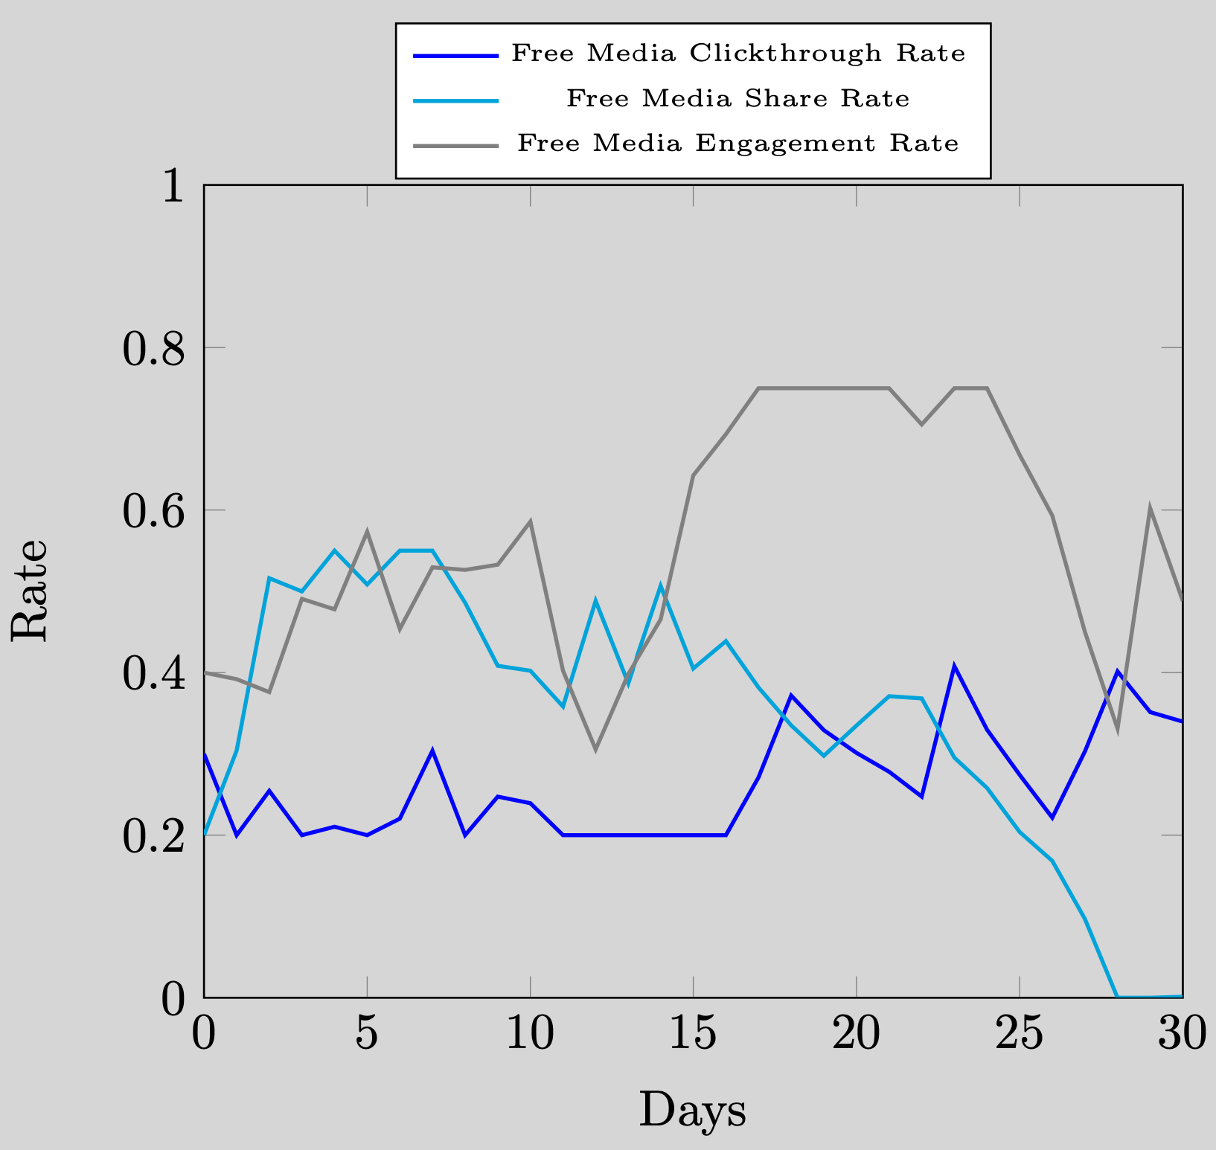
Analysis
Aggregate Trends Over Time
Individual Correlation to Trends
Story vs Total Share Rate

Slide 22
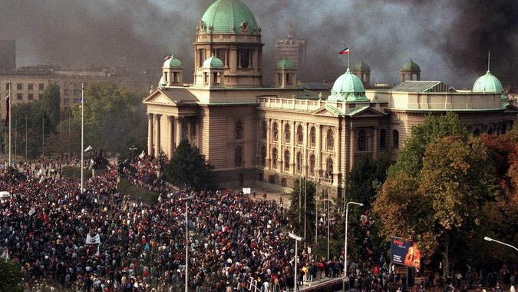
Notes:
So what is the upshot of confronting Putin’s disinformation warfare. Well on October 5th of 2000, the Bulldozer Revolution in Yugoslavia occured. It was colloquially named this because Radio Television of Serbia building, which was a symbol of state sponsored disinformation, was charged.
https://en.wikipedia.org/wiki/Overthrow_of_Slobodan_Milo%C5%A1evi%C4%87

Slide 23
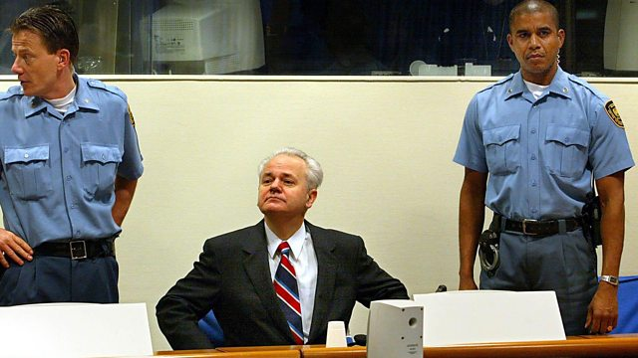
Notes:
This coincided with this man, Milosevic, AKA the Butcher of Bosnia, the be the first head of state since the Nazi regime to face his war crime in court.
https://en.wikipedia.org/wiki/Trial_of_Slobodan_Milo%C5%A1evi%C4%87
https://www.cfr.org/timeline/leaders-facing-justice
Search (Ctrl-F) for “Milosevic” in link directly above for context
milo se vich
https://en.wikipedia.org/wiki/Trial_of_Slobodan_Milo%C5%A1evi%C4%87
https://en.wikipedia.org/wiki/Overthrow_of_Slobodan_Milo%C5%A1evi%C4%87

Slide 24
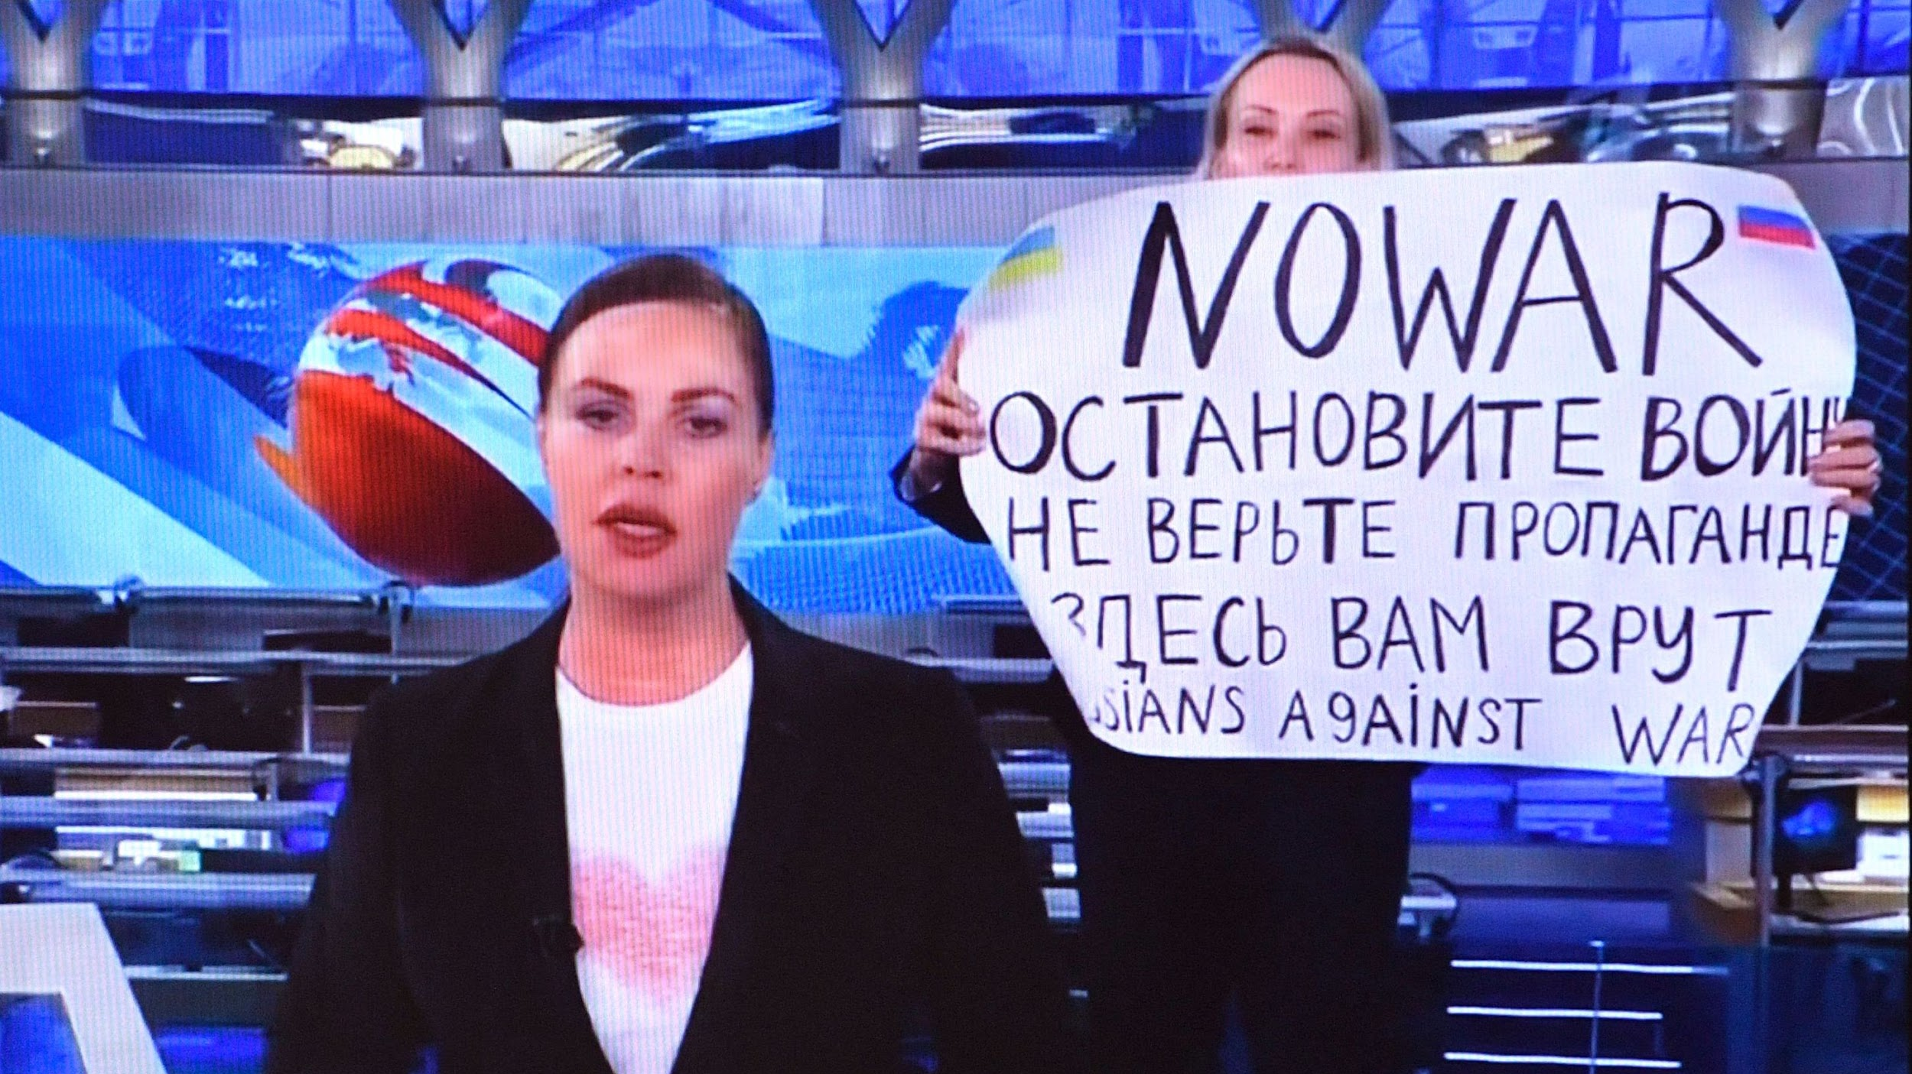
Notes:
We hope that our products can assist in fighting back against Putin’s disinformation warfare, like this brave executive producer in Moscow, hopefully

Slide 25
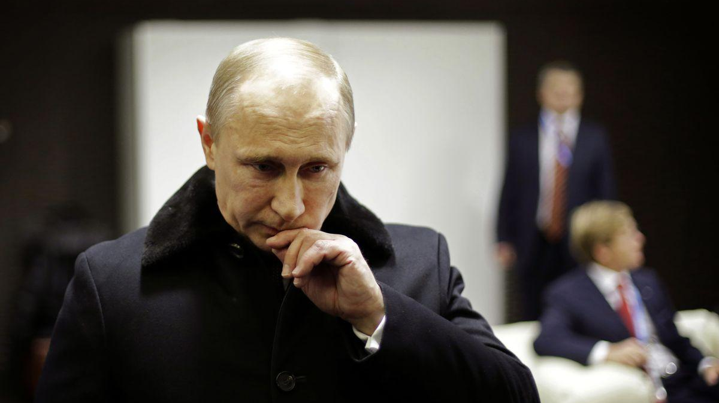
Notes:
Leading to grave concern for this man.

Slide 26
Questions?

Slide 27
Appendix

Slide 28
Cluster Daily Item Count

Slide 29
Cluster WoW Average Growth %

Slide 30
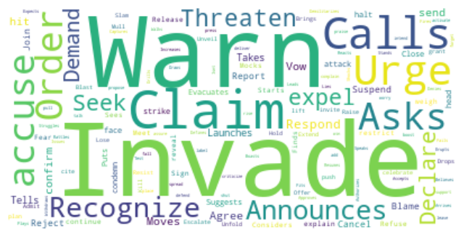
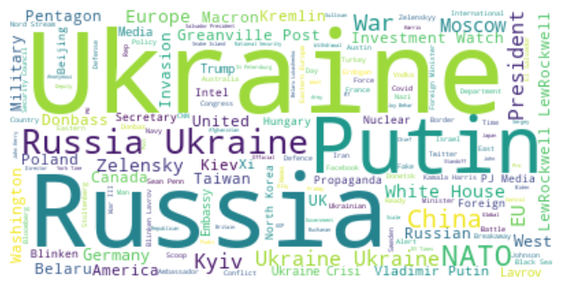
POS Extraction & Word Clouds
VBZ Verbs
NNP Nouns

Slide 31
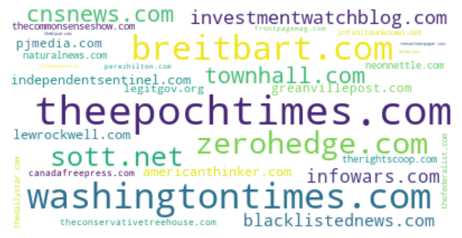
Source Tracking & Exposure Inference
Domains
Source Counts
Google Analytics
Followers
Notes:
perhaps we shrink the number of examples
ask JSIG if its too technical

Slide 32
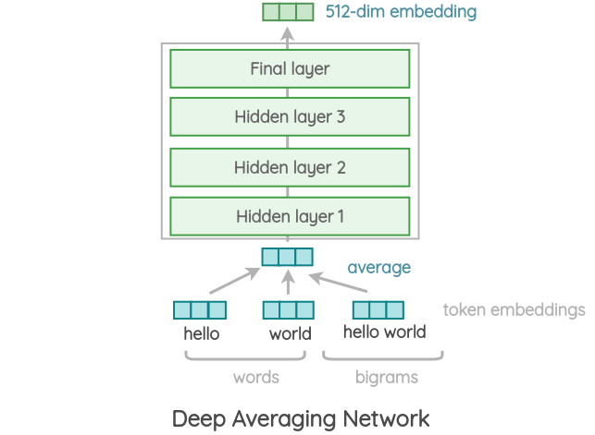


Embedding &
Encoding
Embedding
Word -> Vector
Encoding
Sentence -> Vector
Deep Learning

Slide 33
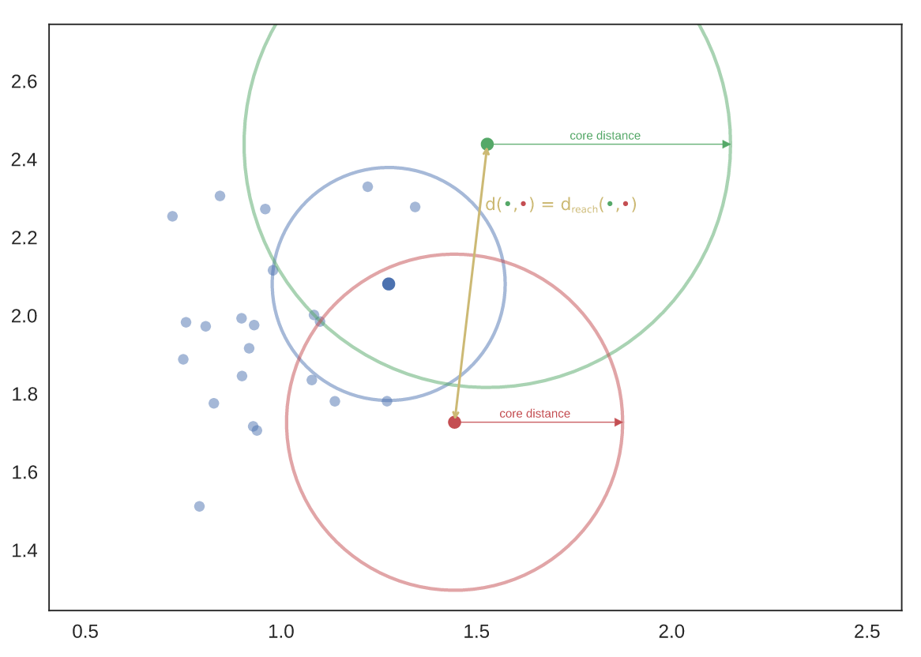
Clustering
Mutual k-Nearest Neighbor
Density-Based
Soft Clustering

Slide 34
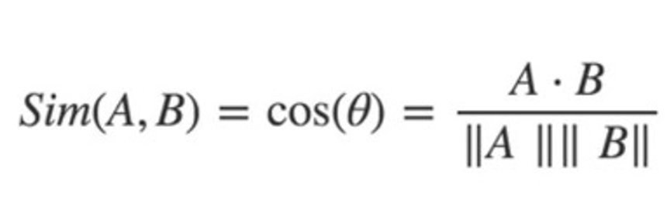
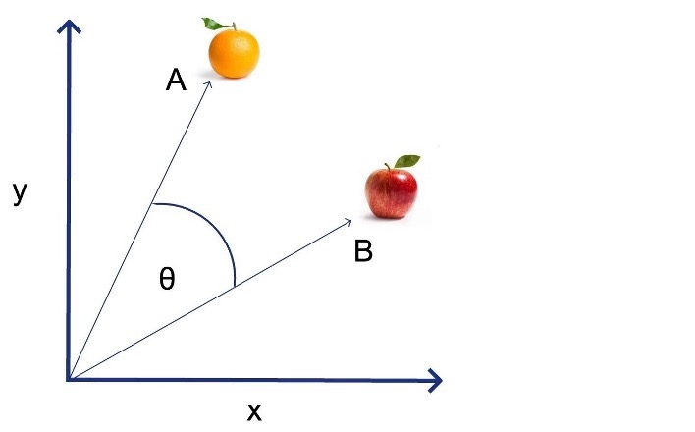
Cosine
&
Angular
Similarity
Similarity Score
Angular Similarity
Based on Cosine Similarity
Notes:
perhaps we shrink the number of examples
ask JSIG if its too technical

Slide 35
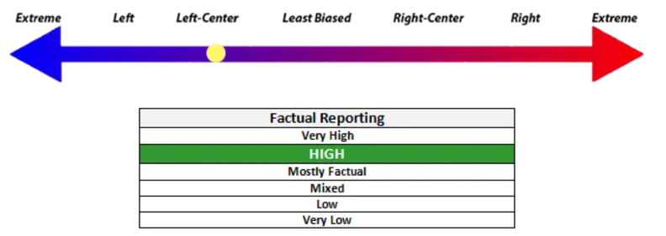

Source
Bias
State Sponsored vs Free Media
Political Bias
Source Based

Slide 36

Sentiment
Natural Language Processing
Valence
0 to 1
Absolute Difference

